Slide 1
Disks
Created by Dr. Ali Hadi
Edited by Safaa Hriez

Slide 2
File system
File system
Gives OS a road map to data on a disk
Type of file system an OS uses determines how data is stored on the disk
A file system is usually directly related to an OS
When you need to access a suspect’s computer to acquire or inspect data
You should be familiar with the computer’s platform

Slide 3
Disk drive
Disk drives are made up of one or more platters coated with magnetic material
Disk drive components
Geometry
Head: range between 0 – 254 (formerly to be 0 – 15)
Tracks
Cylinders: range between 0 – 1023
Sectors: range between 1 – 63

Slide 4
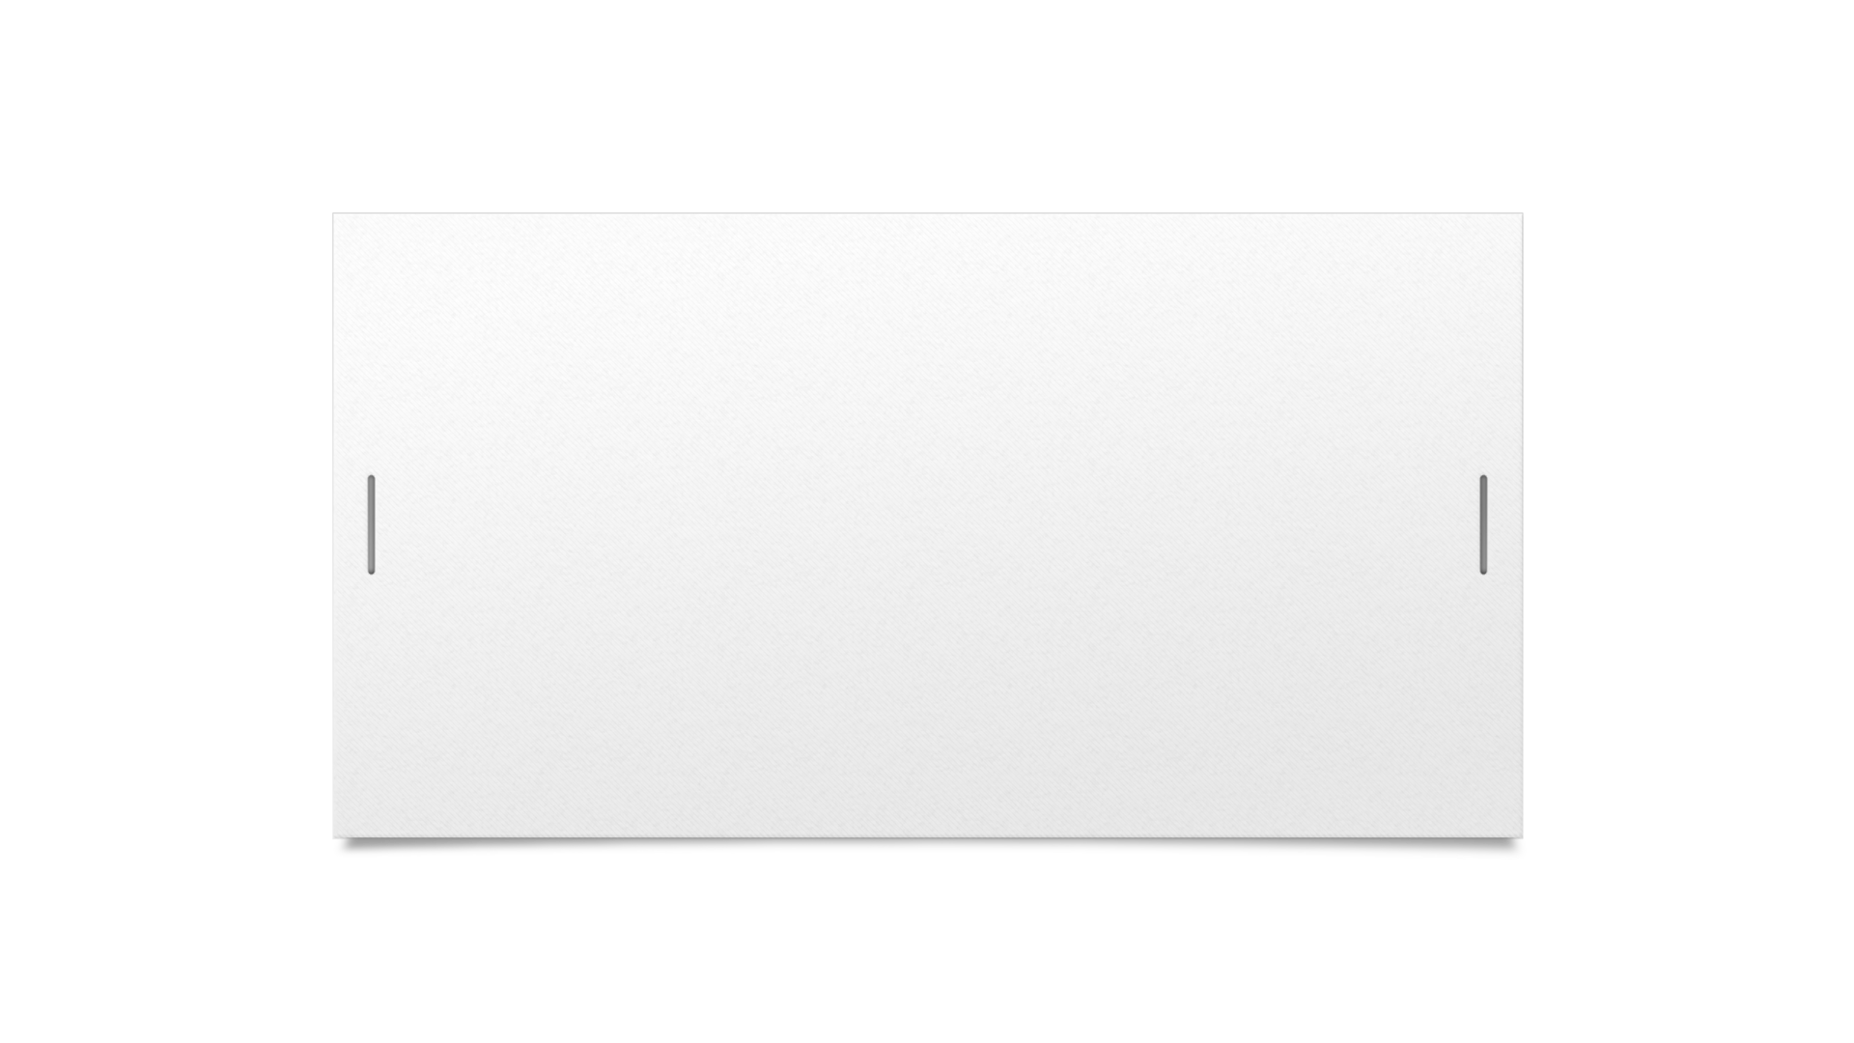

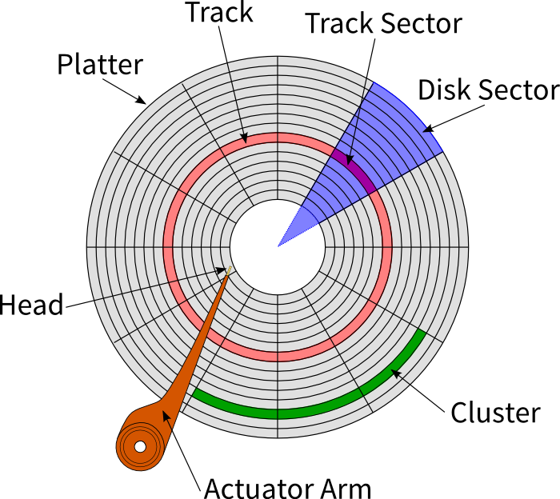

Disk structure

Slide 5
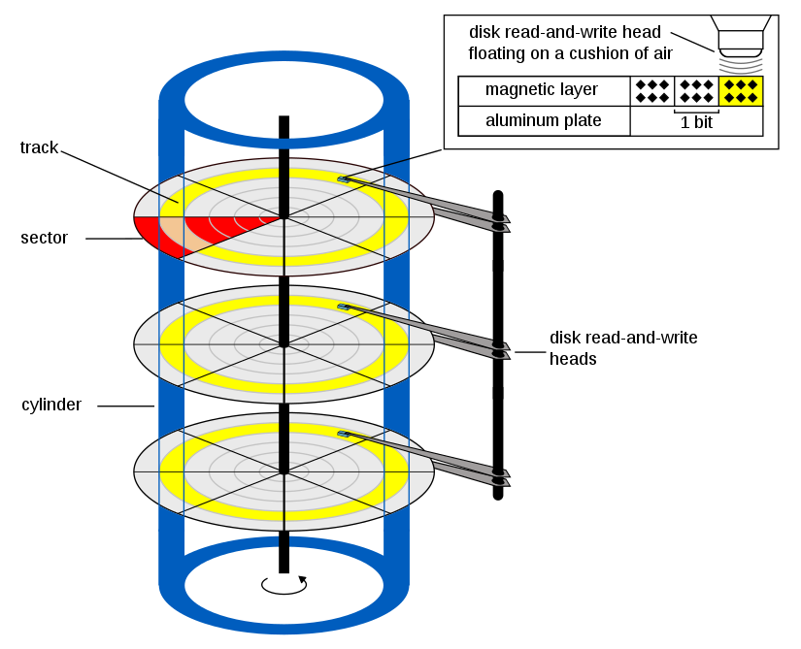
Disk structure (continued)

Slide 6
File structure
Sector: A sector is the smallest addressable unit of storage on a disk. It represents a fixed-size portion of the disk surface that can hold a specific amount of data, typically 512 bytes or 4,096 bytes (4 KB). Sectors are used for low-level disk operations, such as reading and writing data.
Cluster: A cluster, also known as an allocation unit, is a logical grouping of sectors used by the file system to organize and allocate disk space for files. A cluster consists of one or more contiguous sectors, and its size is determined by the file system during disk formatting. The cluster size is typically larger than a single sector and is chosen to balance efficiency in disk space utilization and file system performance. Clusters are typically 512, 1024, 2048, 4096, or more bytes each.

Slide 7
File structure (continued)
Combining sectors minimizes the overhead of writing or reading files to a disk
Clusters minimize overhead by reducing the number of actions required to read/write a file.
Instead of reading multiple sectors individually, a file stored in clusters can be read in a single action by retrieving the cluster's beginning address and size.
One drawback of clusters is that they can lead to wasted space.
If a file is smaller than the cluster size, it still occupies the entire cluster, resulting in unused space.

Slide 8
File structure (continued)
If you know that all the files that will be saved on your device are small files, then choose the cluster size to be small.
This approach ensures efficient space utilization for files that do not require large clusters and minimize the wasted space.
If you know that all the files that will be saved on your device are big files, then choose the cluster size to be big.
Larger clusters allow the file system to process data in larger chunks, improving read and write speeds.

Slide 9
File structure (continued)
OS assigns these cluster numbers, called logical addresses
Sector numbers are called physical addresses
Clusters and their addresses are specific to a logical disk drive, which is a disk partition
Command can be used to check the size: fsutil fsinfo ntfsinfo C: or fsutil sectorinfo C:

Slide 10
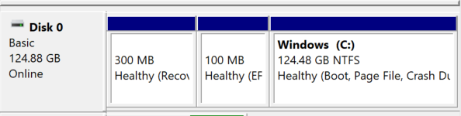
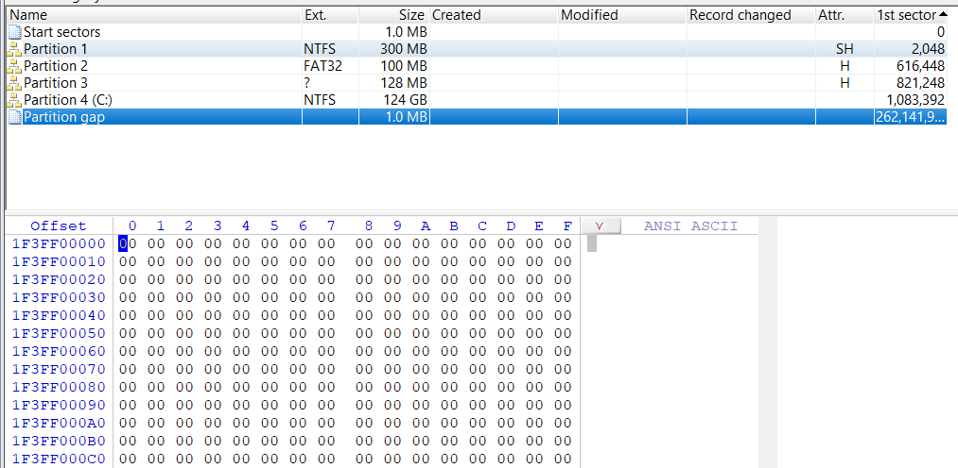
Disk partition
A partition is a logical drive
Large disks are better to be partitioned
Partition gap
Unused space between partitions
Disk editor utilities can be used to alter these spaces!

Slide 11
Disk partition
Disk editor utility can alter information in partition table
To hide a partition
Can examine a partition’s physical level with a disk editor:
Norton DiskEdit, WinHex, or Hex Workshop
See MBR partition table entry!!!!!

Slide 12
Master Boot Record (MBR)
The most common partition structure
Used on IBM PC based computer systems
Boot disk contains a file called the Master Boot Record in the first sector
MBR stores information about partitions on a disk and their locations, size, and other important items
Several software products can modify the MBR

Slide 13
MBR (continued)
Byte Range | Length | Description | Essential
0 --> 445 | 446 | Boot Code | No
446 --> 461 | 16 | Partition Table Entry #1 | Yes
462 --> 477 | 16 | Partition Table Entry #2 | Yes
478 --> 493 | 16 | Partition Table Entry #3 | Yes
494 --> 509 | 16 | Partition Table Entry #4 | Yes
510 --> 511 | 2 | Signature value (0xAA55) | No
MBR contains:
Boot code
Partition table
Signature value

Slide 14
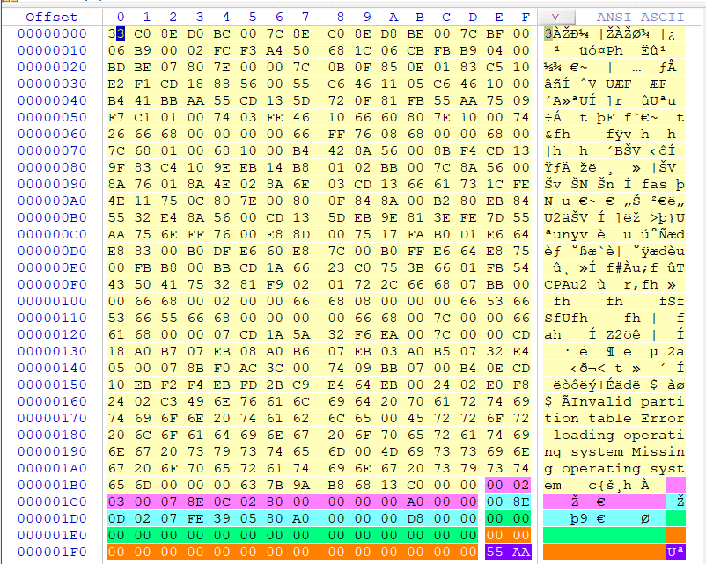
Boot code
Partition table entry #1
Partition table entry #2
Partition table entry #3
Partition table entry #4
Signature value

Slide 15
MBR – Boot code
Boot code
contains the instructions that tell the computer how to process the partition table and locate the operating system.
Standard boot code processes the partition table in the MBR and identifies which partition has the bootable flag set
Find partition, and execute code found
Boot loader might need more than 446 bytes! (jmp to the loader EB 09)

Slide 16
MBR – partition table
Byte Range | length | Description | Essential
0 --> 0 | 1 | Bootable Flag | No
1 --> 3 | 3 | Starting CHS Address | Yes
4 --> 4 | 1 | Partition Type | No
5 --> 7 | 3 | Ending CHS Address | Yes
8 --> 11 | 4 | Starting LBA Address | Yes
12 --> 15 | 4 | Size in Sectors | Yes
Partition Table
Each entry = 16 byte
Four entries, each can describe a partition
partition entry is written in little endian (Little endian stores with the least significant byte first (low address) in smallest address; read from right to left.)

Slide 17
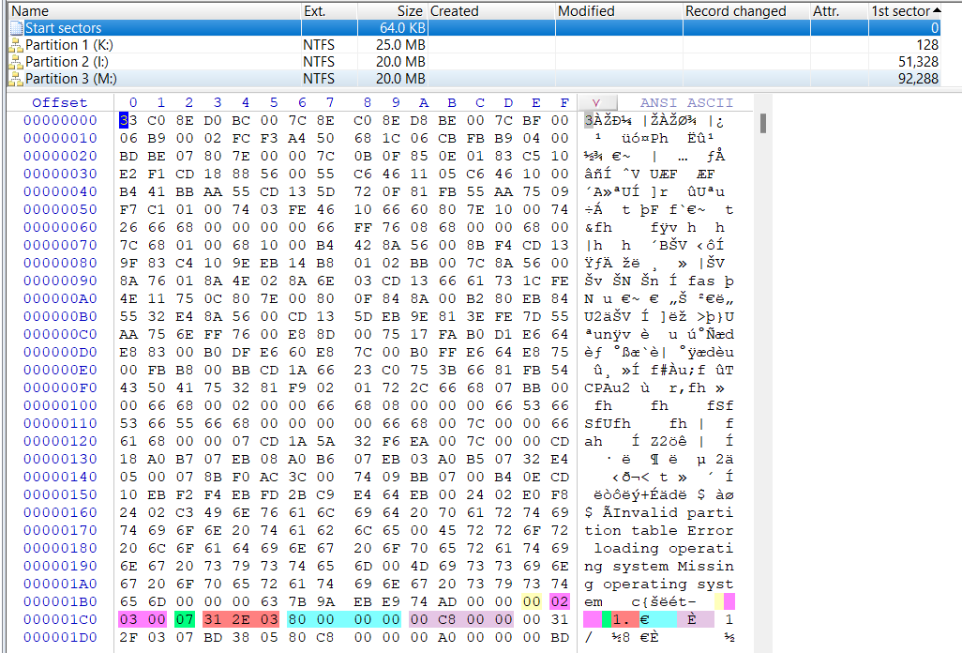
Partition type
Ending CHS address
Bootable flag
Starting CHS address
Starting LBA address
Size in sectors

Slide 18
MBR – partition table (continued)
Bootable flag field identifies which partition is the “bootable" one.
Used to identify where the operating system is located when the computer is booting.
80 means bootable 0 means not bootable

Slide 19
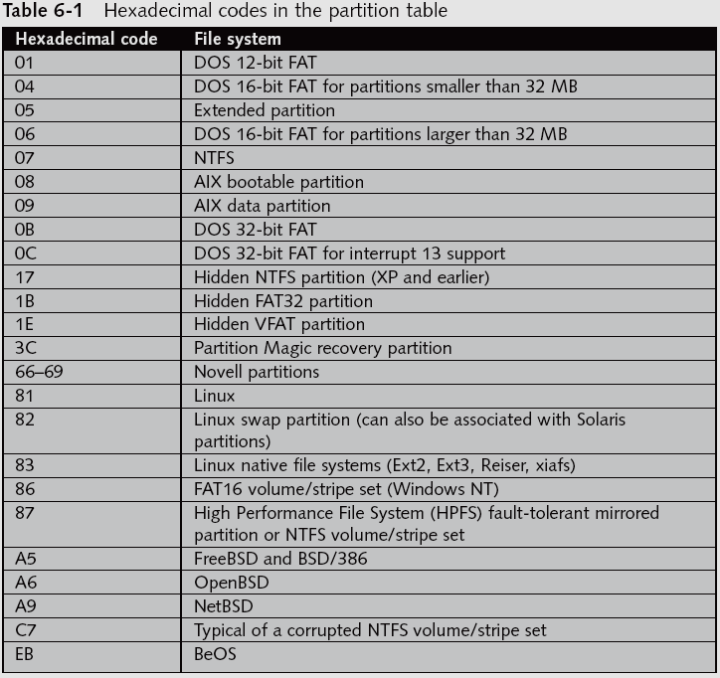
MBR – partition table (continued)
Type field identifies what type of data should exist in the partition (FAT, NTFS, EXT, etc)

Slide 20
MBR - partition table (continued)
Each table entry describes the layout of a partition in both Cylinder/Head/Sector (CHS) and Logical Block Address (LBA) addresses
First sector is LBA 0 or CHS 0/0/1
Note:
CHS addresses used with disks less than 8 GB in size
LBA addresses allow disks to be terabytes (TB) in size

Slide 21



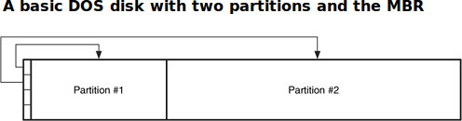
MBR - partition table (continued)
Using the four entries in the MBR, we can describe a simple disk layout with up to four partitions.
We need more than four?
Solution is to use one, two, or three of the entries in the MBR for normal partitions “primary” and then create an "extended partition" that will fill up the remainder of the disk

Slide 22
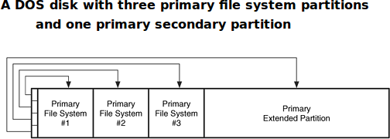
Primary partition
Primary file system partition:
partition whose entry is in the MBR and the partition contains a file system or other structured data
Primary extended partition:
partition whose entry is in the MBR, and the partition contains additional partitions

Slide 23
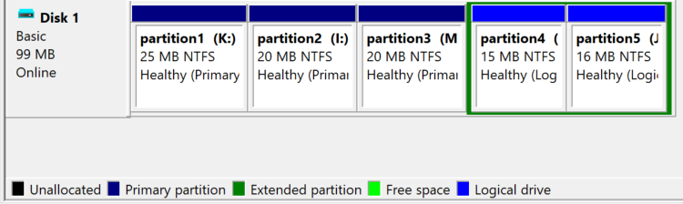
Secondary partition
Secondary file system partition, also called a logical partition, is located inside the primary extended partition bounds and contains a file system or other structured data

Slide 24
